Slide 1
S.R. SHIPPING & LOGISTICS
Prompt & Reliable Service

Slide 2
About Us
Who we are and what we do!
S.R. Shipping & Logistics provide customer specific solutions through a wide range of value creating services like local, national, international transportation, ware housing and distribution services. Our services will allow you to make all the right moves for your business. We offer PAN INDIA services.
WE PROVIDE CONSIGNMENT NOTE(C.N)APPROVED BY INDIAN BANK ASSOCIATION (IBA)MEMBERS.ASSOCIATION MEMBER)
Managed by professionals with more than 20years of experience in the industry, customized to your particular needs. Below is the detailed list of general services offered, which can be personalized according to your business needs.

Slide 3
SERVICES PROVIDED
INTERNATIONAL & DOMESTIC
Sectors :
Land based services :
Domestic & International Sectors - Nationwide (Rail/Roadways)
Port to Port
Import & Export clearance purposes.
WE PROVIDE CONSIGNMENT NOTE(C.N) APPROVED BY INDIAN BANK ASSOCIATION (IBA) MEMBERS.
Surface/Land Transportation for
Bangladesh
Nepal
Bhutan
Import and Export clearance from Bangladesh , Nepal & Bhutan Land Customs Stations.

Slide 4
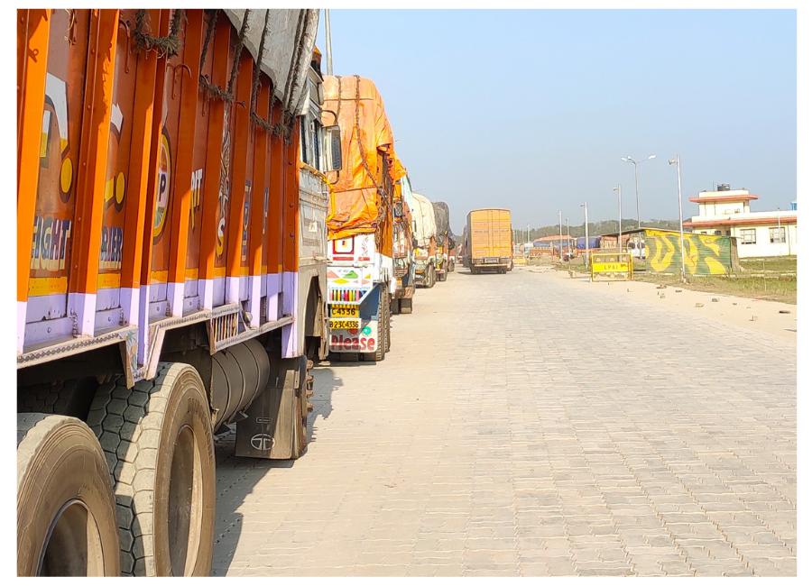
Surface / land based transportation
(Railways & Roadways )
Surface Transportation of Part Load : Transport delivery services, Nation Wide through our own network.
We provide a customised solution in terms of commercial aspects and tailor made requirement based on the budget of the customers.
We provide Truck for Import , Export & Clearance Purposes .
Full Truck Load Surface Transportation : PAN INDIA NETWORK through Any Vehicles ,(COVERED CONTAINER/VAN, OPEN BODY TRUCKS(16 WHEELER/12 WHEELER/10 WHEELER) & Smaller Vehicles)

Slide 5
Railway Transportation -
Surface Transportation for Bangladesh, Nepal & Bhutan : Import and Export Clearance from Bangladesh Nepal & Bhutan border.
Railway Transportation -
i) Port to Port.
ii) Port to Door Services..
iii) Total Customized solution for Import and Export.

Slide 6
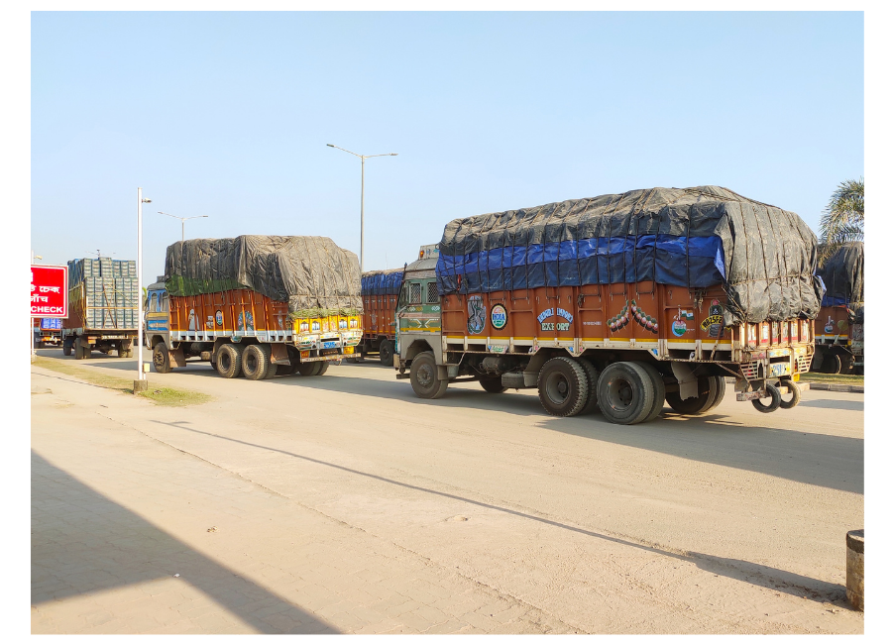
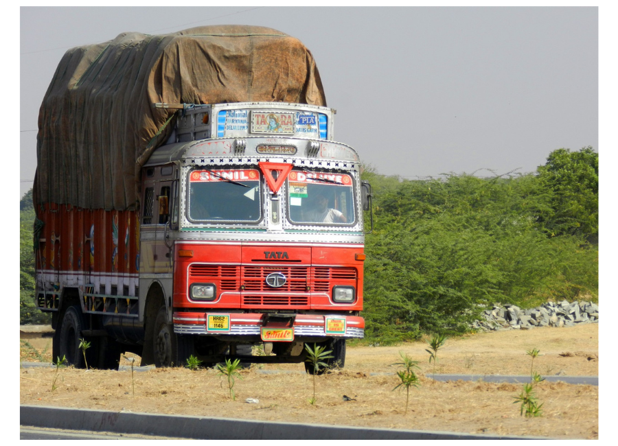
LET US HANDLE YOUR FREIGHT EFFICIENTLY!

Slide 7
Thank You From
Mr. Arun Kumar Roy (Founder & C.E.O)
+91-9733690759 & +91 9333736428
Mr. Srikanta Chattopadhyay (Admin)
FABRIKAM RESIDENCES
+91-7044186551
srshipping111@gmail.com
www.srshippinglog.com

Slide 8
S.R. SHIPPING & LOGISTICS
Corporate Office:
30, Ganesh Chandra Avenue, 1st Floor, Suite No. 04, Kolkata – 700013
Branch Office :
"JATINDRA BHAVAN",ROOM NO.C7,1ST FLOOR,VILL+P.O+P.S}PETRAPOLE,DIST-NORTH 24 PARGANAS,PIN-743405,WEST BENGAL.
E-mail - srshipping111@gmail.com
E-mail - contact@srshippinglog.com
Web : www.srshippinglog.com

